Slide 1

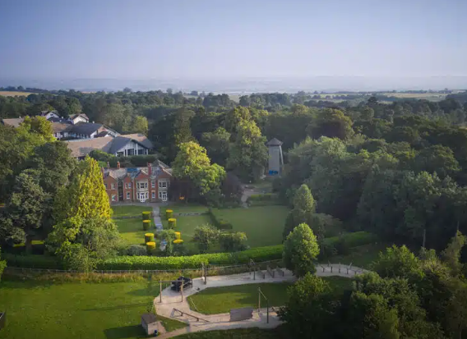
Liddington multi activity 2 night 3 day Residential
Arrival date and time: Monday 20th April.
Children will need to be in school at usual time. Leaving time (TBC). Parents are welcome to wait in café and enjoy a cuppa with the luggage!
Arriving Liddington by lunchtime. Children will need a packed lunch to eat on arrival.
Return date and time: Wednesday 22rd April, leaving after lunch (after 2:00pm)
There will be a text message sent out with the arrival time.

Slide 2
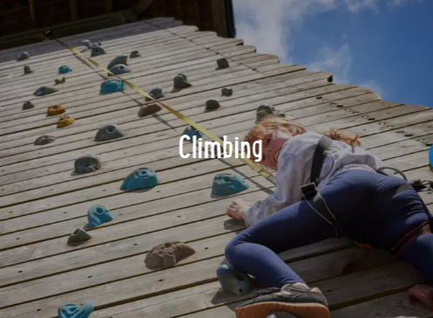
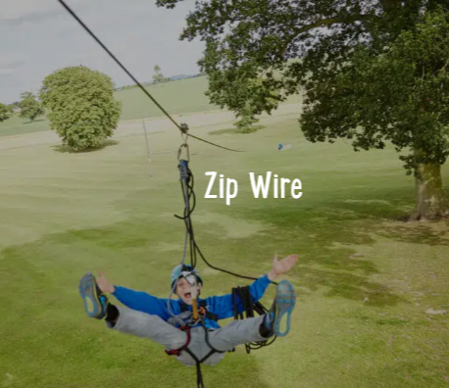
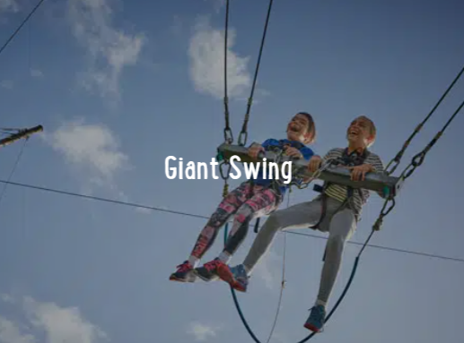

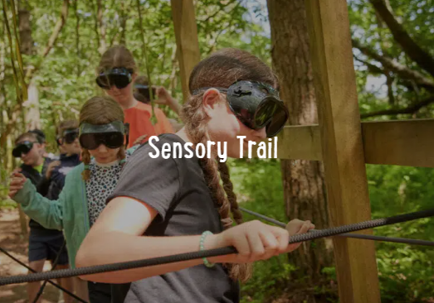
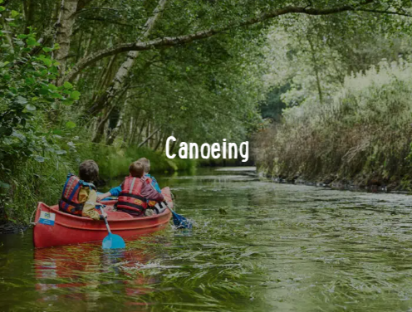
During the residential the children will be given the opportunity to participate in the various activities, including:
Raft Building
Zip wire
Giant swing
Climbing
Canoeing
Balloon Splash
Sensory trail
Problem solving
Campfire

Slide 3
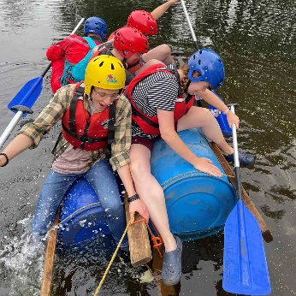
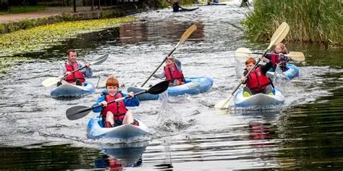
Things you will need to bring…
· Sturdy footwear (high rope based activities)
· Tops that cover the child's shoulders (high rope based activities)
· Shorts that cover their thighs (high rope based activities)
· Long trousers (low level rope activities, fencing)
· Old, warm clothing (the sensory trail will be muddy)
· Fleece (the weather will probably by quite cool)
· Clothes that can be layered (the weather will probably by quite cool)
· Glasses retainer (some of the activities involve jumping, and moving quite quickly)
· Closed toe shoes (for all activities)
· Long sleeved tops (for rope based activities)
· Loose fitting clothing
· Long socks
Towel x2 (they will need to wash and will be doing wet activities!)
Sleeping bag or duvet and a pillow
Many activities will involve water, so please ensure your child has multiple changes of clothes for each day and plastic bags for any wet items coming home.

Slide 4
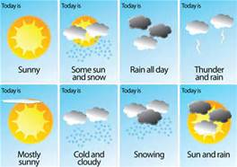
As you are aware, the weather is very interchangeable at the moment, please ensure that you have appropriate clothing for each activity.
The majority of activities are outdoors.

Slide 5

Things you must leave at home…
Mobile phones- the staff will have your numbers, please make sure that all contact details are given to Miss Scott.
Any electrical items such as PS,Nintendos etc- you will be far too busy to play with these things.
Loop or long earrings, please leave valuable jewellery at home. The venue and staff take no responsibility for any loss of valuable items.
Excessive amount of sweets and snacks. Food is provided.
Flip flops, sandals or crocs can only be worn in the rooms.
A maximum of £15 is permitted per child. The children are responsible for their own money.

Slide 6
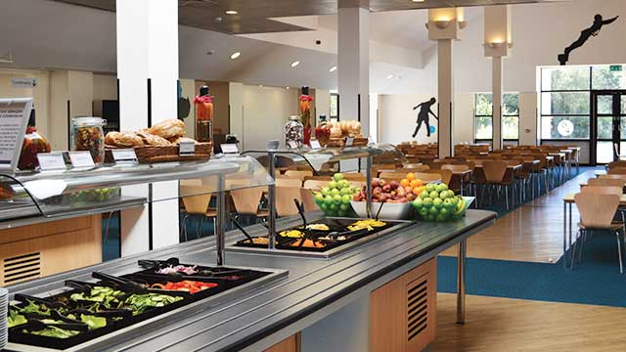
Food

Slide 7
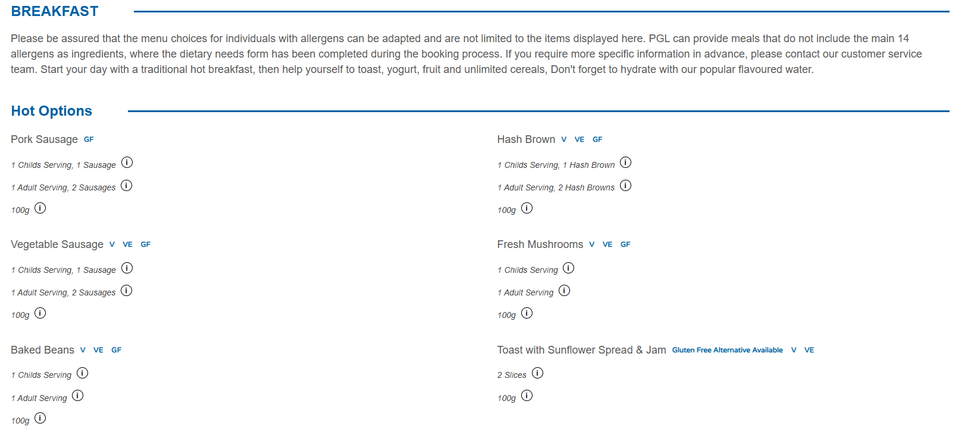
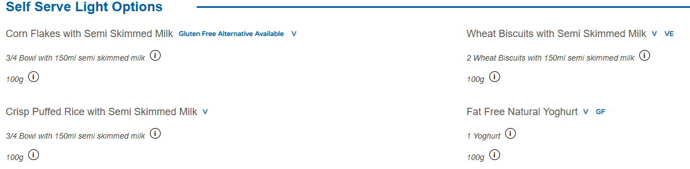
Food- Breakfast

Slide 8
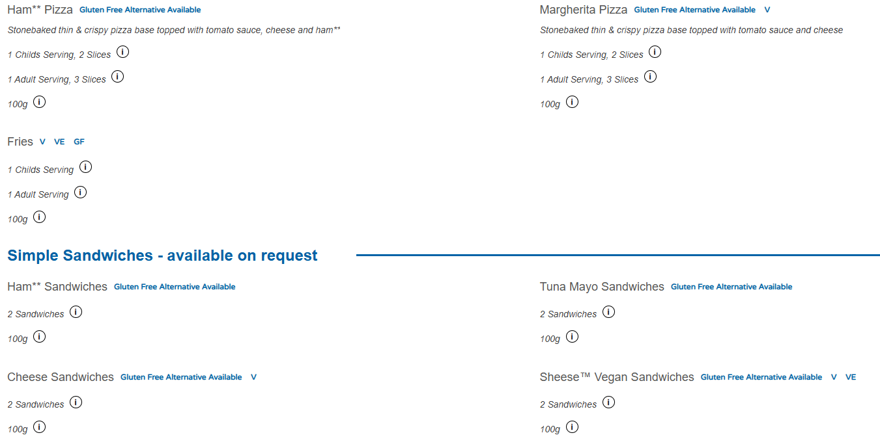
Food- Lunch

Slide 9
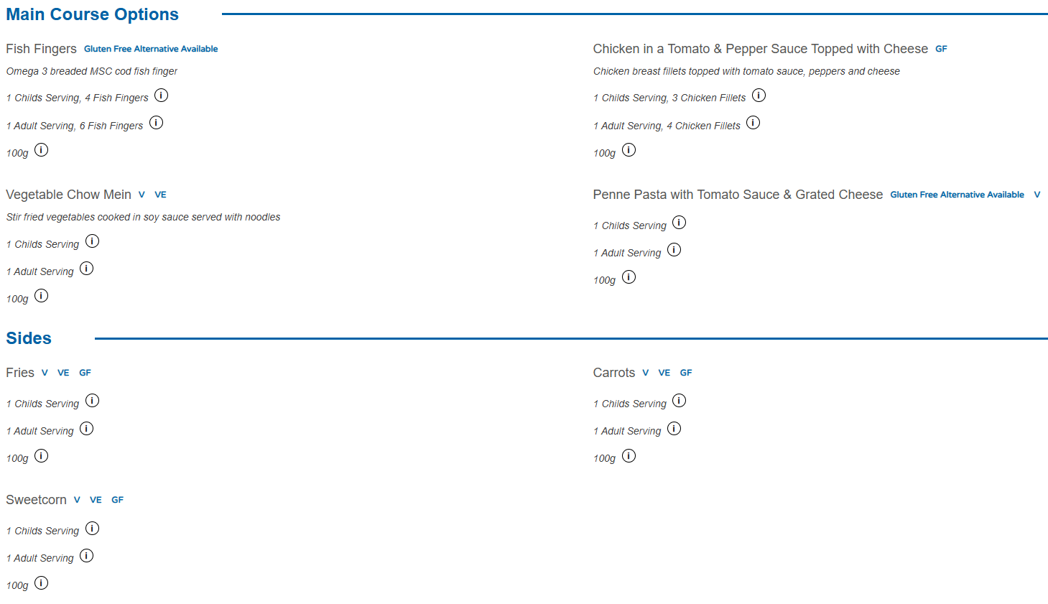
Food- Dinner

Slide 10
Who’s going?
Mrs Cari Kinnear
Mrs Erin Edwards
Miss Laura Pearce

Slide 11
Behaviour and expectations.
This is an ideal experience for your child. They will learn new skills, build on communication and work as a team. The activities are exciting and fun. However safety is paramount and a zero tolerance policy is enforced during this residential.
Any children who do not comply with the rules of behaviour and is a possible safety risk to themselves or others will not be permitted to do an activity and may be sent home-if necessary.
The staff at Liddington have the last say on who is able to do activities. All activities are risk assessed by the staff at PGL to ensure the safety of all pupils.

Slide 12

Behaviour policy and expectations.
Courtesy - any disrespect to staff or property at Tregoyd will result in
a warning.
Self control- any physical harm to others will result in a warning or a
possible phone call home.
Use of inappropriate language – is not tolerated and will result in a warning.
Attitudes- any answering back or cheekiness will result in a warning.
Not listening- will result in a warning.
During the visit the traffic light system will be used by all staff members. Any child who reaches the yellow light for the second time, the consequence will result in a phone call home. Any child who reaches the red light - parents will be contacted to collect their child.

Slide 13
A typical full day at PGL Liddington
8-8:30 - Breakfast
8:50-10:20 Zip wire
10:30-12:00 Problem solving
Lunch
2:10-3:40 Giant swing
3:50-5:20 Canoeing
Dinner
7:30-8:30: Team Games/Campfire
Shop time
Lights off by 10:00 (at the latest) ☺

Slide 14
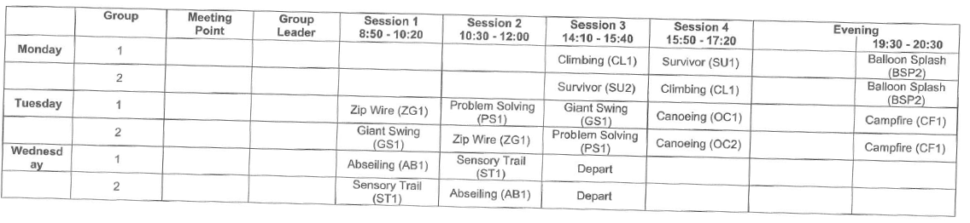
A typical full agenda at PGL Liddington

Slide 15

Medication
ALL medication (even if your child takes it unsupervised at home) is given to a member of staff attending the trip on the day of departure.
Please ensure that your child's name, year group, dosage and when to take the medication is written clearly with the medication and placed in a bag.
All medication will remain with the staff for the duration of the trip.

Slide 16
Shop time
No more than £15 spending money.
Money is to be placed in an envelope with your child's name, amount and year group written clearly on the front.
The staff will be collecting the money, and keeping it safe, when the shop is not open.

Slide 17
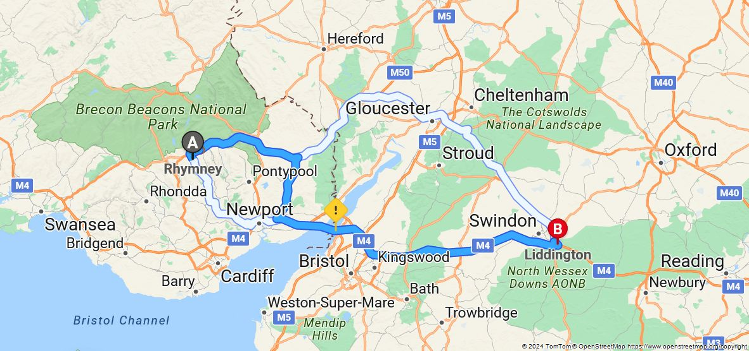
Contact details
PGL Liddington
Fox Hill
Liddington
Swindon
SN4 0DZ
PGL Adventure
Tel: 0333 321 2100

Slide 18

Just one more thing……
Medical Forms
If you haven’t already, please could you complete one before leaving (even if there are no medical requirements!)
Diolch x

Slide 19
A big thank you….
The staff attending this residential are providing your child (and possibly themselves!) with a lifelong experience. It will help your child to communicate, socialise, raise self esteem and confidence.
All safety measures are put in place for a reason and we expect all pupils to abide by the rules. We ask that you support the staff and reiterate to your child our rules and expectations of them during these three days away.
And last but not least, thank you for your support!

